Slide 1
Theory of Separation of Power and the concept of Checks and Balances
Dr. S. M. Ali Reza
July 19, 2018

Slide 2
Theory of Separation of Powers
Rationale:
“Power corrupts and absolute power corrupts absolutely” (Lord Acton).
Concentration of authority degenerates into tyranny, corruption and abuse of powers.
The functions of the state is performed by the government through its three branches: legislature, executive and judiciary.
These three organs represent the will of the people and are responsible for the smooth functioning of a democratic government.
All the branches of the government have equal importance and functions.
Each branch of the government should be made independent of others.
This led to the introduction of the concept of Separation of Powers.

Slide 3
Theory of Separation of Powers
Pioneers of the concept:
Earlier philosophers who demanded the separation of powers- Jean Bodin, John Locke.
Systematic and scientific formulation of the concept by Montesquieu, a French Jurist in his book “Esprit de Lois” (The Spirit of Laws, 1748).
Montesquieu for the first time extensively discussed the doctrine and its form.

Slide 4
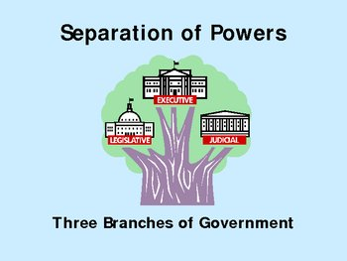
Theory of Separation of Powers

Slide 5
Montesquieu’s Separation of Powers
Montesquieu writes:
“When the legislative and executive powers are united in the same person, or the same body of magistrates, there can be no liberty…Again there is no liberty if the judicial power is not separated from the legislative and executive…” (The Spirit of Laws).
According to Montesquieu’s theory, no one person body should be vested with all three types of powers.

Slide 6
Montesquieu’s Separation of Powers
There must be a division of functions on the following basis:
‘The legislature should make laws but not administer or enforce them, the executive must administer the made laws but neither influence the legislature in the making of the laws nor stand in judgment of the same and the judiciary must determine rights and uphold justice without taking over the functions of law-making or administration.’
Such separation is necessary in order to ensure that justice does not become arbitrary and capricious.

Slide 7
Montesquieu’s Separation of Powers
Principles of the theory of separation of powers:
A different body of persons is to administer each of the three departments of governments and that no one of them is to have a control over the either of the others;
No concentration of powers;
Diffusion of powers needed;
System of checks and balances;
Such separation is necessary for the purpose of preserving individual liberty and for avoiding tyranny.

Slide 8
Montesquieu’s Separation of Powers
Justification:
It aims at individual liberty and is a safeguard against despotism;
Its basic principle that concentration of powers leads to dictatorship is true for all time and ages;
Separation of power saves people from the arbitrary rule of the executive;
Under this theory, each organ acts as a check upon others;
It maintains the efficiency in the administration.

Slide 9
Montesquieu’s Separation of Powers
Criticisms/drawbacks:
Complete separation of powers leads to non-cooperation and disharmony among different organs of government.
There would be frequently deadlocks which may bring the government machinery to standstill.
This may result in a clash between the three organs of government, as each one will take interest only in its own powers.
It makes a mistake in assuming that the three branches of government are equally powerful and can be independent of one another.

Slide 10
Separation of Powers: US Experiences
The US constitution is based on the theory of separation of powers.
Constitutional provisions:
All legislative powers herein granted shall be vested in a Congress (Article 1). The legislature alone exercises law making power.
The executive power shall be vested in a president of the United States. He is not responsible to he Congress (Article 2).
The judicial power shall be vested in the supreme court. The judiciary is independent of the executive and the legislative (Article 3).

Slide 11
Separation of Powers: US Experiences
A concrete evidence of this theory is seen in the US constitution as the position of the president under the constitution has been secured by providing fixed tenure of office, the legislature is not subject to any executive control, and a judge cannot be removed once appointed.
Congress consists of two houses- the Senate and the House of Representatives. Both are directly elected by the people for a fixed period.
Neither the president nor the Congress are responsible to each other.
The Senate has no power to choose, control or dismiss the executive or the judiciary; the executive also cannot dissolve the legislature and dismiss judges.

Slide 12
US Theory of Checks and Balances
James Madison (1787): by separating the powers of different institutions “tyranny of the majority” would be countered.
The separation of powers provides a system of shared power known as Checks and Balances. Three branches are created in the Constitution (Article 1, 2 &3).
With checks and balances, each one of the three branches of government can limit the powers that the other branches has. This way no one branch becomes too powerful. Each branch checks the power of the other branches to make sure that the power is balanced between them.

Slide 13
US Theory of Checks and Balances
Example: The process of law making
The legislative branch introduces and votes on a bill.
The bill then goes to the executive branch which free to decide on the bill ( ref. veto power/ pocket veto).
With enough votes the legislature can override the executive decision, and the bill becomes law.
A law can be challenged in the Court (judicial branch).
If a law is questioned by the court, the legislative introduces a new piece of legislation.

Slide 14
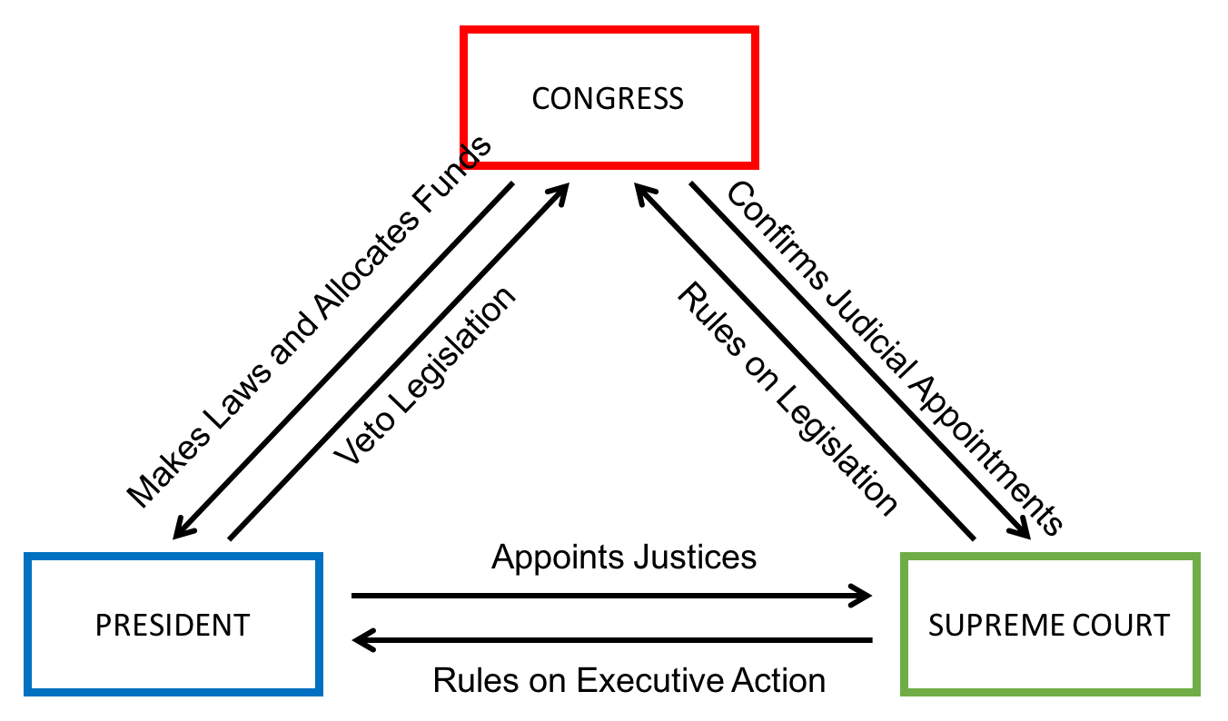
Images of the Theory of Checks and Balances

Slide 15
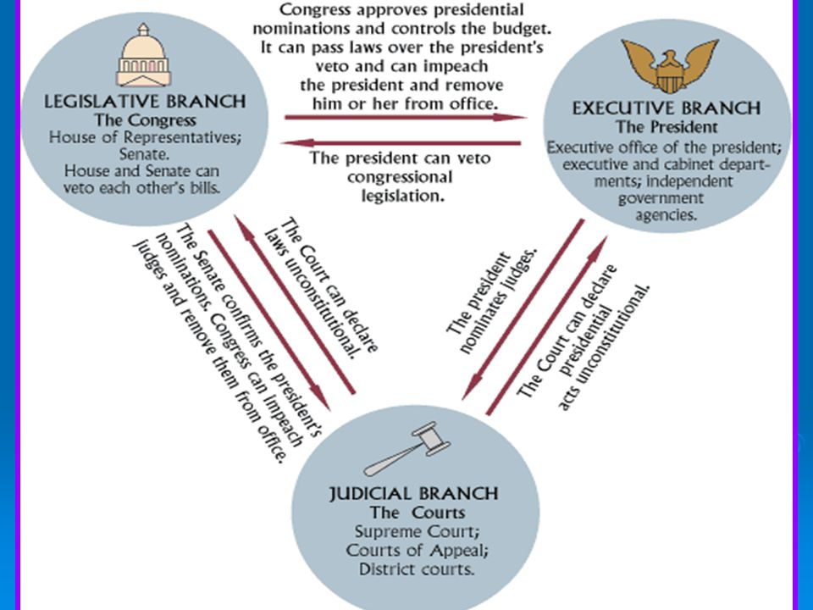
Images of the Theory of Checks and Balances

